Slide 1
Controls
Jon Kolko Professor, Austin Center for Design

Slide 2
Interaction
Interface
Control

Slide 3
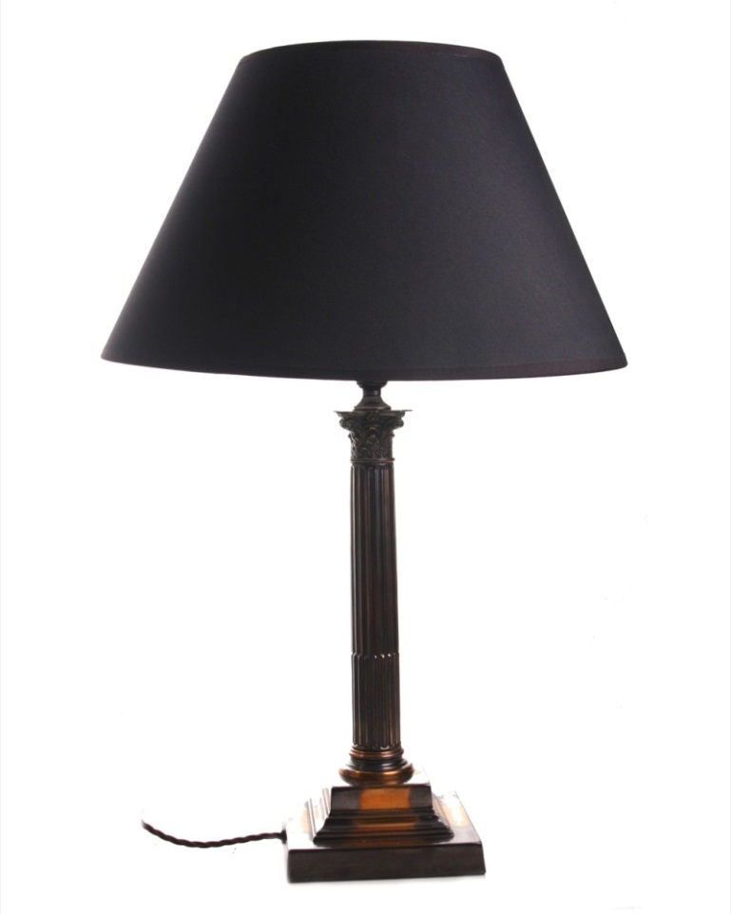
How do you turn on the light?

Slide 4
How do you turn on the light?
...
Interface: Transformer
Interface: Wiring on Telephone Pole
Interface: Circuit Breaker Box
Interface: Lightswitch
Interface: Wire to outlet in wall
Interface: filament to bulb receptor

Slide 5
How do you turn on the light?
Increased level of abstraction between human and technology
Increased convenience
Increased role of design
...
Interface: Transformer
Interface: Wiring on Telephone Pole
Interface: Circuit Breaker Box
Interface: Lightswitch
Interface: Wire to outlet in wall
Interface: filament to bulb receptor

Slide 6
How do you turn on the light?
A control

Slide 7
How do you turn on the light?
A complex system
A control

Slide 8
How do you know how to turn on the light?
A control

Slide 9
How do you know how to turn on the light?
Perception
Affordance
Mapping
Prior Experience
Visibility
Proximity
Trial and Error
Feedback

Slide 10
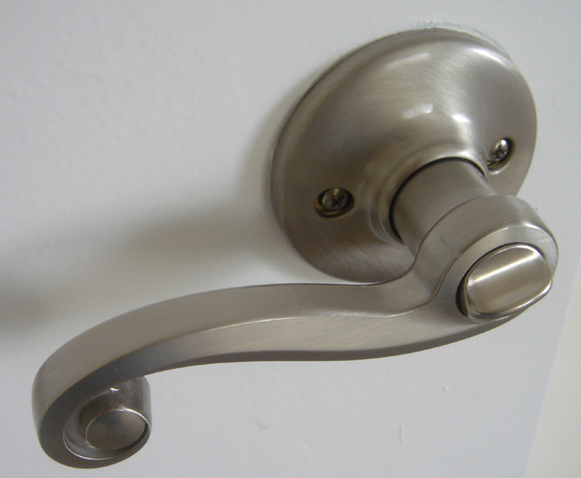
Describe, using this new vocabulary:
Perception
Affordance
Prior Experience Mapping
Visibility
Proximity
Trial and Error
Feedback

Slide 11
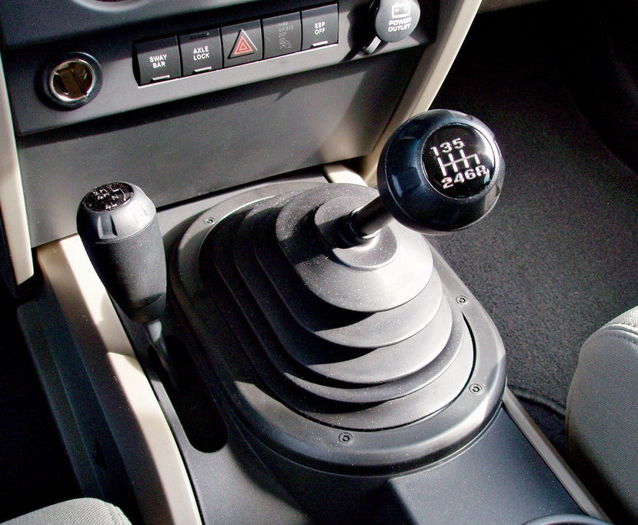
Describe, using this new vocabulary:
Perception
Affordance
Prior Experience Mapping
Visibility
Proximity
Trial and Error
Feedback

Slide 12
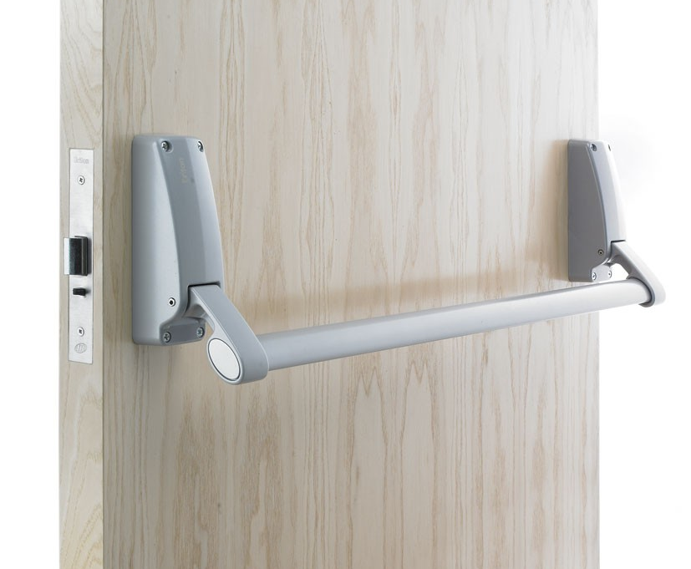
Describe, using this new vocabulary:
Perception
Affordance
Prior Experience Mapping
Visibility
Proximity
Trial and Error
Feedback

Slide 13
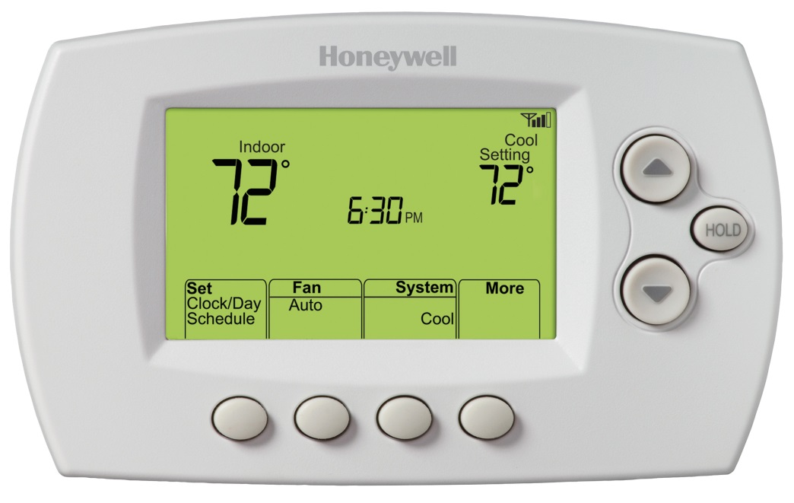
Describe, using this new vocabulary:
Perception
Affordance
Prior Experience Mapping
Visibility
Proximity
Trial and Error
Feedback

Slide 14
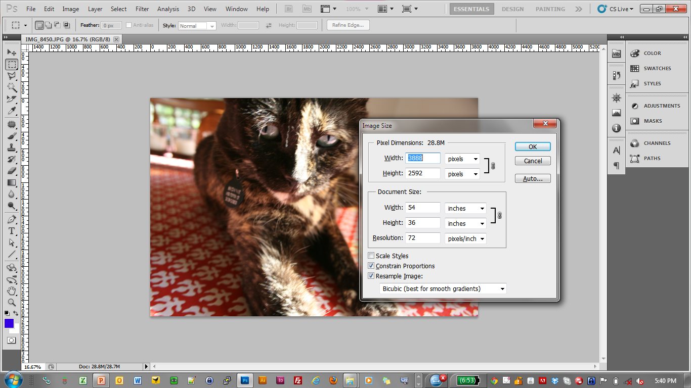
How do you resize this picture?

Slide 15
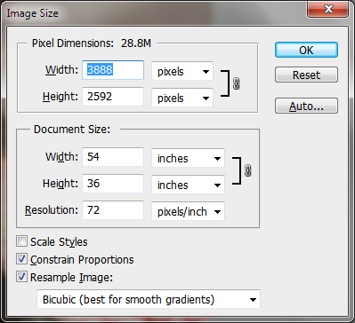
How do you resize this picture?
A complex system
A series of controls, laid out in a form

Slide 16
How do you know how to resize the picture?
A complex system
A series of controls, laid out in a form

Slide 17
Interface controls are an abstraction, intended to help us perform “higher level tasks” with minimal errors.

Slide 18
Which is better –
more, or less, abstraction?

Slide 19
Checkbox

Slide 20
Input Box

Slide 21
Radio Buttons

Slide 22
Button

Slide 23
Select Box (Combo Box)

Slide 24
Scrollbar

Slide 25
Dragable Panel

Slide 26
Spinner

Slide 27
Slider

Slide 28
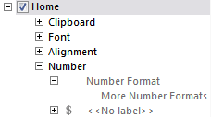
Selection Tree

Slide 29
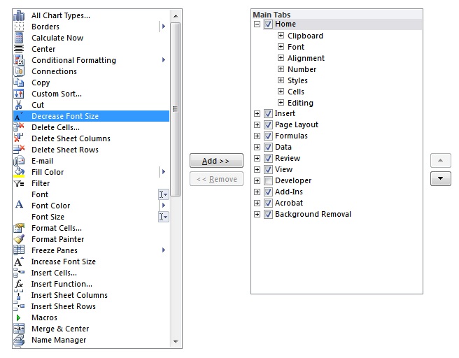
Add/Remove Panel

Slide 30
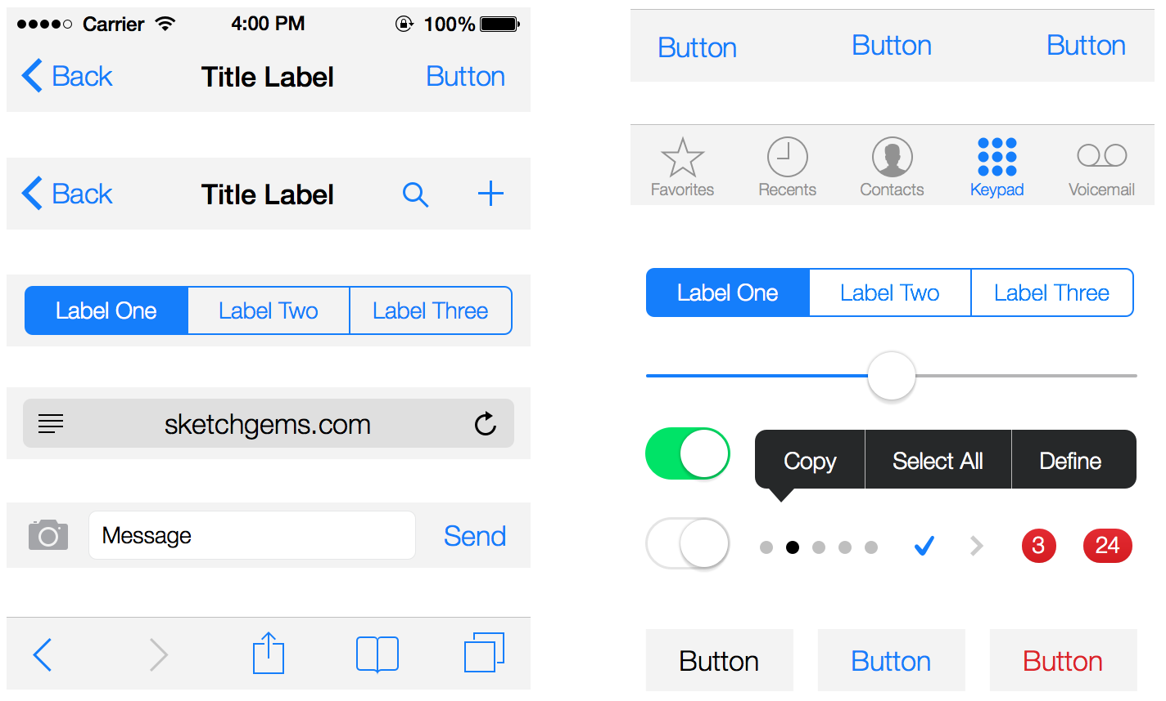
Mobile Controls

Slide 31
A form is a combination of interface controls on one or more pages.

Slide 32
Forms are no fun.

Slide 33
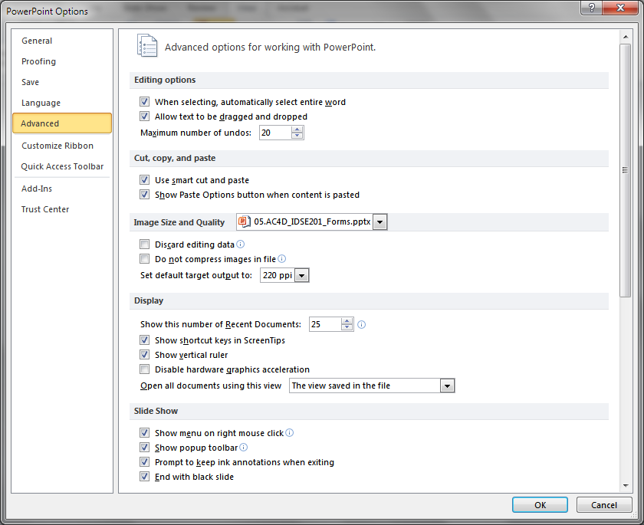

Slide 34
Sometimes, forms are necessary.

Slide 35
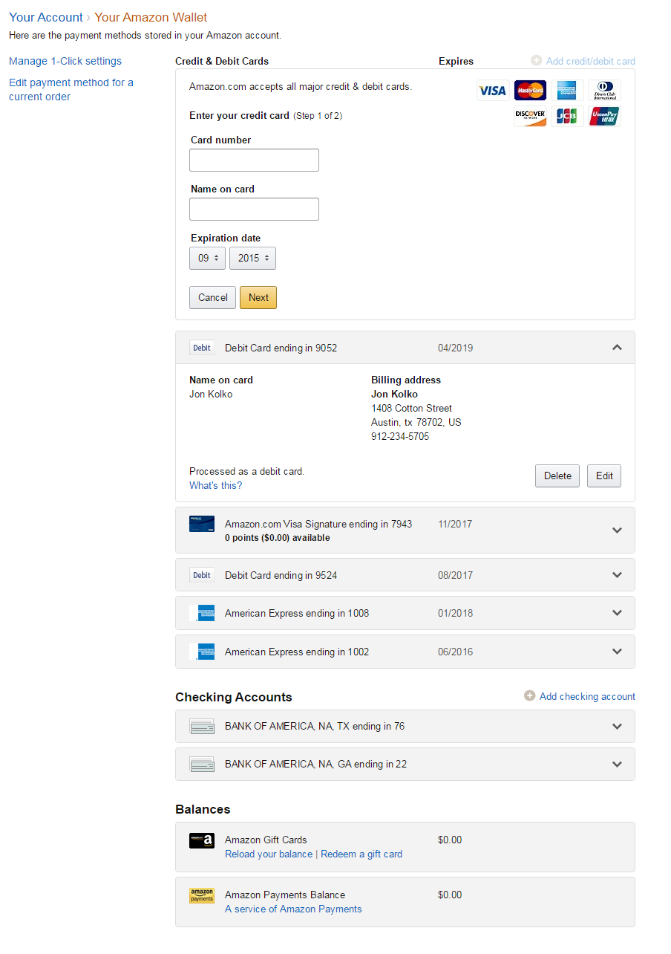

Slide 36
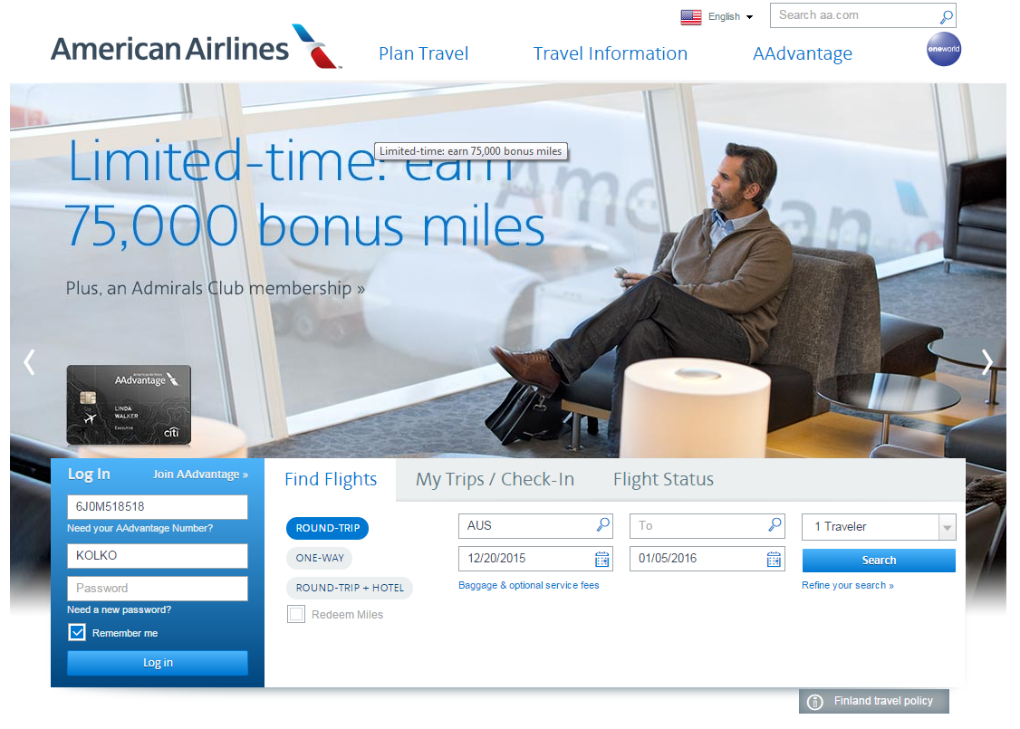

Slide 37
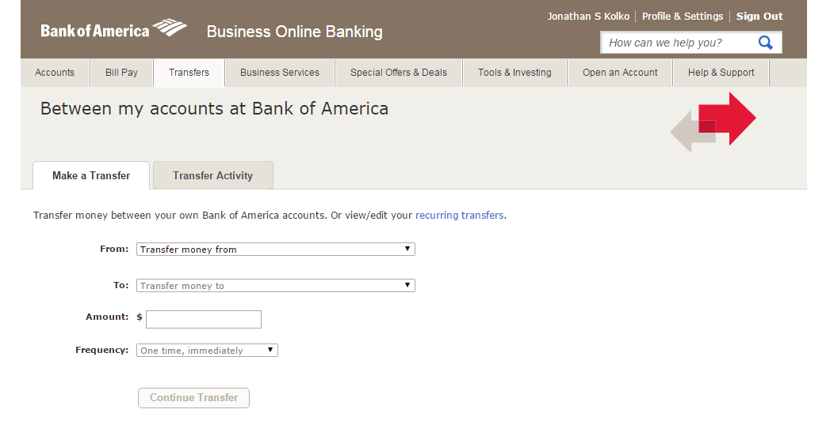

Slide 38
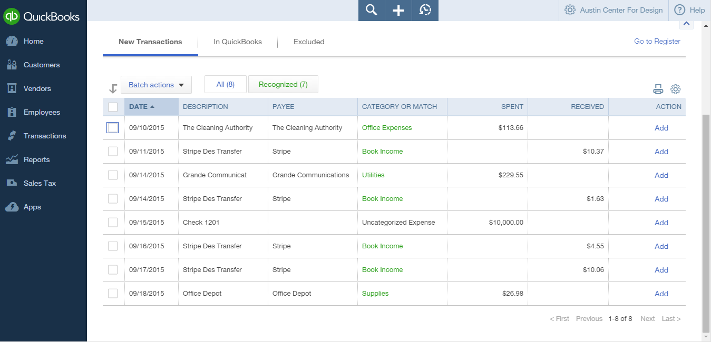

Slide 39
Layout, Order, and Arrangement
Welcome to Joe’s Widget Store.
About You
First Name:
Last Name:
Email Address:
*
Select a Password:
*
Confirm your Password:
*
Would you like to subscribe to our newsletter?
Yes
No
Sign Up
Cancel

Slide 40
Layout, Order, and Arrangement
Welcome to Joe’s Widget Store.
About You
First Name:
Last Name:
*
Email Address:
*
Select a Password:
*
Confirm your Password:
Would you like to subscribe to our newsletter?
Yes
No
Sign Up
Cancel

Slide 41
Layout, Order, and Arrangement
Welcome to Joe’s Widget Store.
About You
First Name:
Last Name:
*
Email Address:
*
Select a Password:
*
Confirm your Password:
Would you like to subscribe to our newsletter?
Yes
No
Sign Up
Cancel

Slide 42
Padding, Margin, Background Colors, Section Breaks
Welcome to Joe’s Widget Store.
About You
First Name:
Last Name:
Email Address:
*
Select a Password:
*
Confirm your Password:
*
Would you like to subscribe to our newsletter?
Yes
No
Sign Up
Cancel

Slide 43
Helper Text
Welcome to Joe’s Widget Store.
About You
First Name:
Last Name:
Email Address:
*
Select a Password:
*
Select a password that is 8-12 characters long, and that you’ll remember.
Confirm your Password:
*
Would you like to subscribe to our newsletter?
Yes
No
We won’t send email more than once a month, we promise!
Sign Up
Cancel

Slide 44
Error / Confirmation Messages & Validation
Welcome to Joe’s Widget Store.
About You
Email Address is required; please enter a valid email address.
First Name:
Jon
Last Name:
Kolko
Email Address:
*
Select a Password:
*
***********
Select a password that is 8-12 characters long, and that you’ll remember.
Confirm your Password:
*
***********
Would you like to subscribe to our newsletter?
Yes
No
We won’t send email more than once a month, we promise!
Sign Up
Cancel

Slide 45
Further Reading
Best Practices for Form Design http://static.lukew.com/webforms_lukew.pdf

