Slide 1
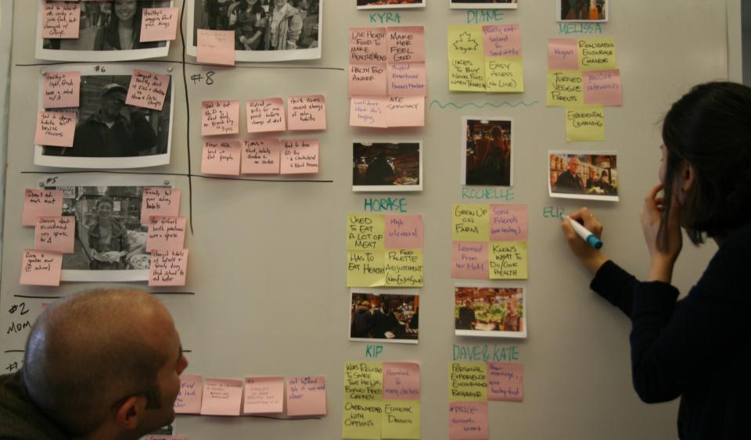
Work Modeling
Jon Kolko Director & Founder, Austin Center for Design

Slide 2
Research
Transcription
Utterances
Patterns & Anomalies
Interpretation
Insights
Ideas
Stories
Designs
Ethnography
Synthesis
Prototyping
The goals:
To make sense of data
To understand intent
To move towards insights

Slide 3
A model..
.. Is a small object, usually built to scale, that represents in detail another, often larger object.
Notes:
3

Slide 4
A model provides a shared understanding of the user-data, a shared language for the design team, and an easily understandable deliverable for communication outside the design team.
Notes:
4

Slide 5
A model provides a shared understanding of the user-data, a shared language for the design team, and an easily understandable deliverable for communication outside the design team.
Notes:
5

Slide 6
A model provides a shared understanding of the user-data, a shared language for the design team, and an easily understandable deliverable for communication outside the design team.
Notes:
6

Slide 7
A model provides a shared understanding of the user-data, a shared language for the design team, and an easily understandable deliverable for communication outside the design team.
Notes:
7

Slide 8
A model provides a shared understanding of the user-data, a shared language for the design team, and an easily understandable deliverable for communication outside the design team.
Most importantly, models give us a visual representation of the user data.
Notes:
8

Slide 9
Contextual Design Modeling:
Slice the research data into different views.
5 Contextual Design Models/
Flow How work is divided among roles and coordinated, without regard for time
Sequence The order of work tasks over time
Cultural The influencers which define expectations, desires, values and the overall approach people take to their work
Physical The physical environment in which work is accomplished
Artifact The tangible items people create and use to help them get their work accomplished
Notes:
9

Slide 10
Flow Model
Notes:
10

Slide 11
Individuals who do the work, shown as circles
Groups (sets of people), shown as circles
Responsibilities of the individual or the group, shown as a list in a circle
Flow of communication, shown as arrows and lines between individuals or groups
Communication topics, shown as labels on the flow lines
Artifacts, shown as small boxes on a flow
Places, shown as large boxes
Breakdowns in communication or coordination, shown as a red lightning bolt and annotated as necessary.
Flow Model
Notes:
11

Slide 12
Sequence Model
Notes:
12

Slide 13
Work tasks are ordered and unfold over time. The steps people take aren’t random; they happen the way they do for a purpose.
Triggers, described in sentences or blurbs
Intents, described in sentences or blurbs
Actions, described in sentences
Breakdowns in doing the steps, shown as a red lightning bolt and annotated as necessary.
Sequence Model
Notes:
13

Slide 14
Cultural Model
Notes:
14

Slide 15
Work takes place in a culture, which defines expectations, desires, policies, values and the whole mindset people take for their work.
Influencers, shown as circles.
The extent of the influence, illustrated by the size of the circles
The influence, shown as an arrow pointing from one influence to another, and described in text.
Breakdowns in cultural influence, shown as a red lightning bolt and annotated as necessary.
Cultural Model
Notes:
15

Slide 16
Artifact Model
Notes:
16

Slide 17
People create, use and modify things in the course of doing work. These things become artifacts, which each tell their own stories.
A visual representation of the object, either drawn, photographed, or scanned
Presentation of the object, including relevant physical characteristics
Information presented by the object, such as the contents of a form
The structure, or grouping, of the parts of the object
Annotations showing informal usage of the object, such as highlighting, post-its, etc
A description of the object and its use, in sentences
Breakdowns in using the artifact, shown as a red lightning bolt and annotated as necessary.
Artifact Model
Notes:
17

Slide 18
Physical Model
Notes:
18

Slide 19
Work occurs in a physical environment that either supports and enabled the work or gets in the way.
Places that work occurs, shown in plan view and annotated
Physical structures that define the space, shown as geometric shapes
Movement throughout the space, shown as arrows and lines and annotated
Hardware, software, and tools that are present, shown visually as appropriate and annotated
Artifacts, shown visually as appropriate and annotated
Breakdowns in the physical space, shown as a red lightning bolt and annotated as necessary.
Physical Model
Notes:
19

Slide 20
Contextual Design Modeling
5 Views of An Experience.
Flow
Sequence
Cultural
Artifact
Physical
Notes:
20

Slide 21
Contextual Design Modeling
5 Views of An Experience.
Flow
Sequence
Cultural
Artifact
Physical
ON ALL MODELS/
Always label all data on the models (citations) with line numbers from the transcript or time on the tape; allowing you to go back to the raw data
Anything unlabeled is a hypothesis
Legibility is very, very, very important!
Notes:
21

Slide 22
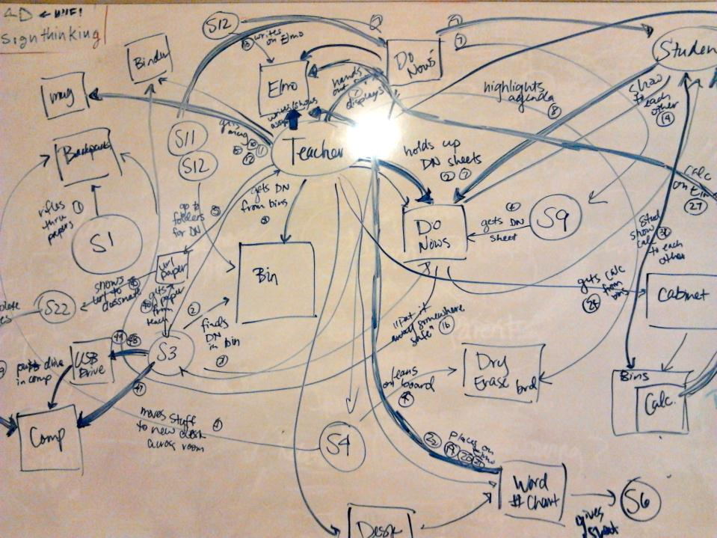
This is a messy process!
Notes:
22

Slide 23
Contextual Design Modeling
Create all five models at once, through an “interpretation session”:
The models are created during an Interpretation Session, which helps us assign meaning to the data.
You’ll need multiple people:
Interviewer
Describes what happened
Answers questions
Draws the Physical Model
Modelers, one each for Work, Sequence, Artifact & Cultural
Recorder, takes note of any design ideas, breakdowns and key points
Notes:
23

Slide 24
Contextual Design Modeling
Create all five models at once, through an “interpretation session”:
Hand out the transcript; make sure everyone has a copy with line numbers labeled
Individually, read the entire interview
As a group, discuss the interview in general terms to make sure everyone is at the same starting point
Assign roles; in a small group, each person may need to perform multiple roles
Set up large sheets of paper on the walls, one for each model
Step through the interview transcript, and begin to create the models. For each line in the transcript, make additions to each model as relevant.
Record observations, insights, influences, questions, design ideas, and breakdowns
Summarize important insights on a separate piece of paper
Notes:
24

Slide 25
Jon Kolko
Director, Austin Center for Design
jkolko@ac4d.com
Download our free book, Wicked Problems: Problems Worth Solving, at http://www.wickedproblems.com
Notes:
25

